Slide 1

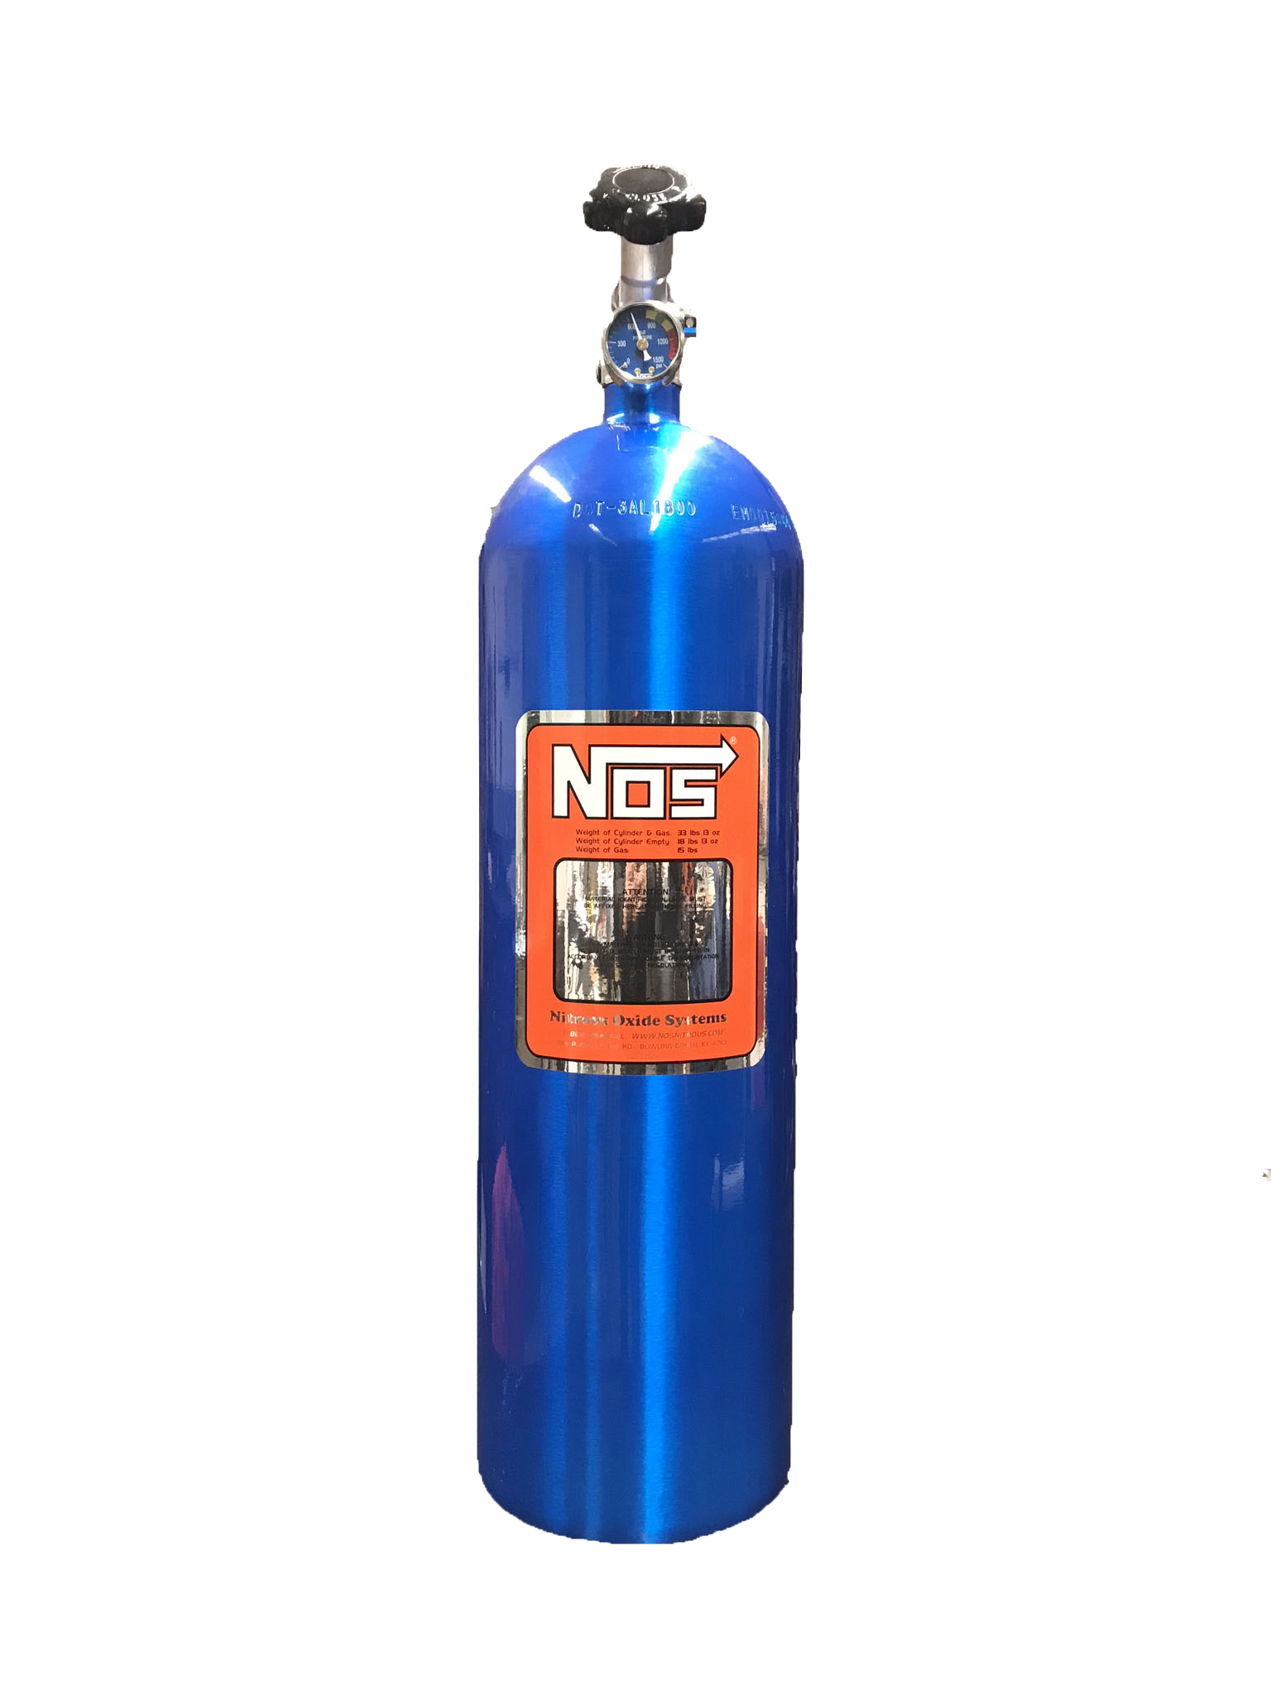





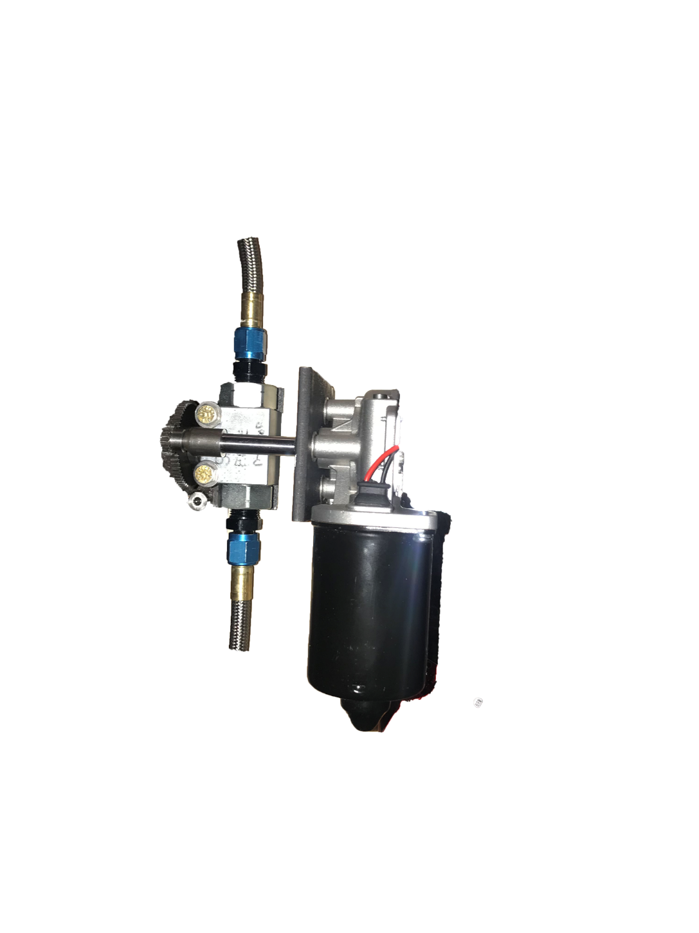
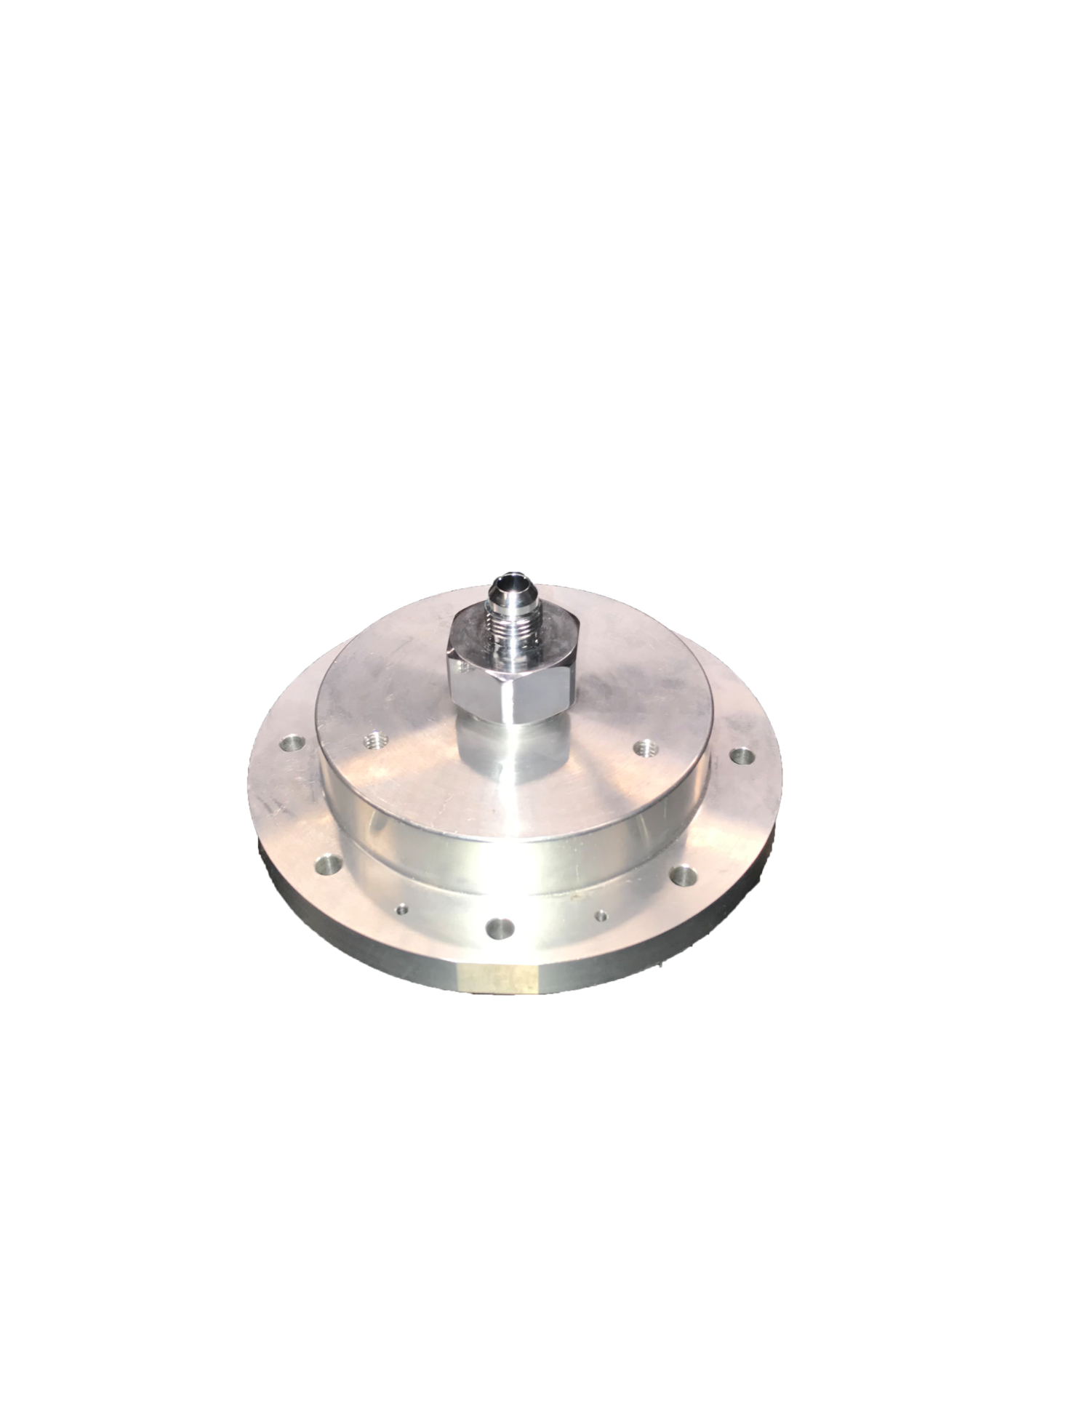
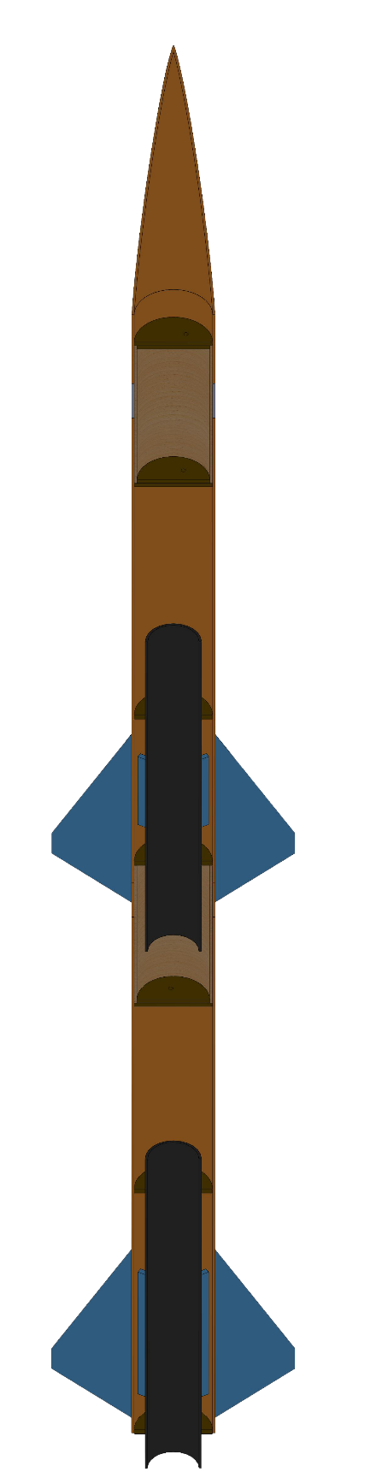
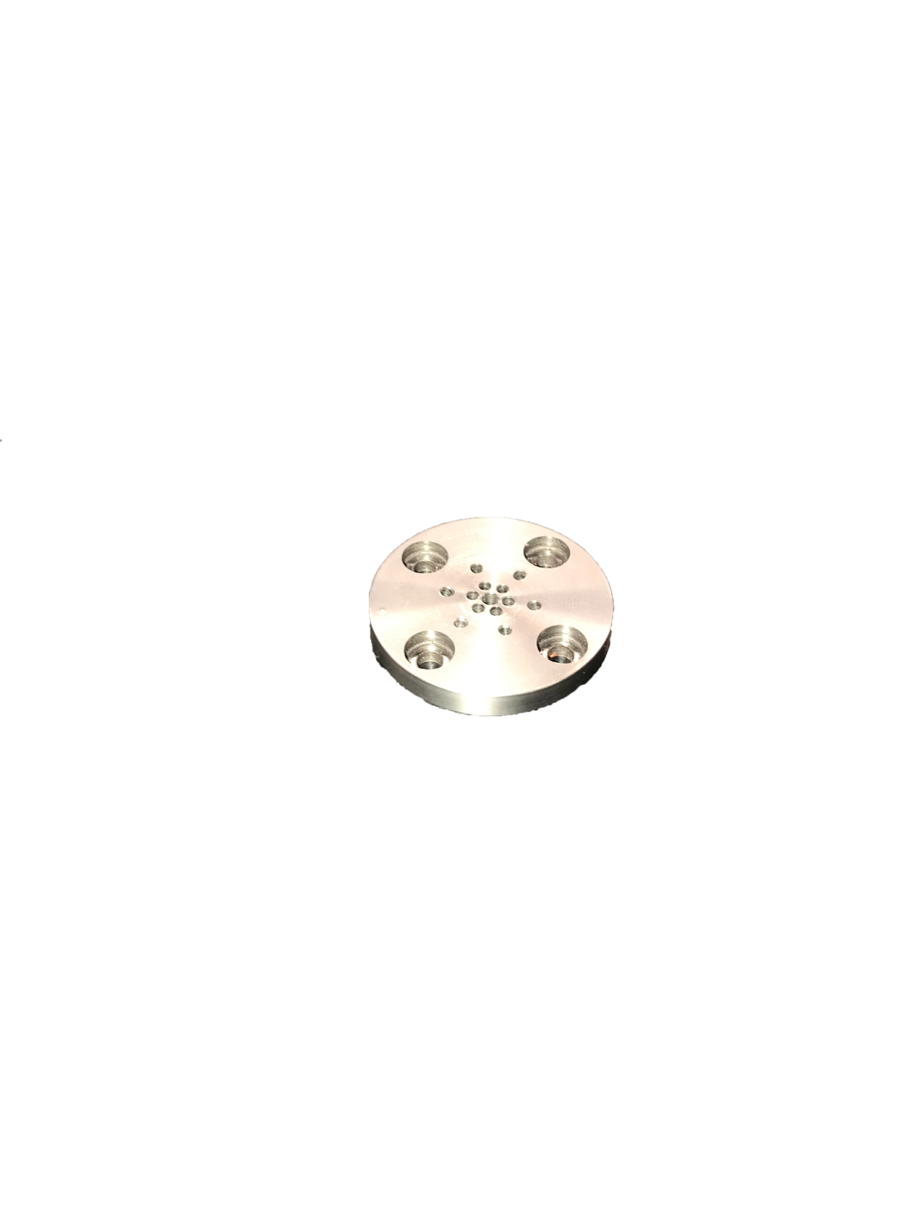


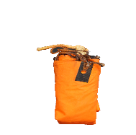
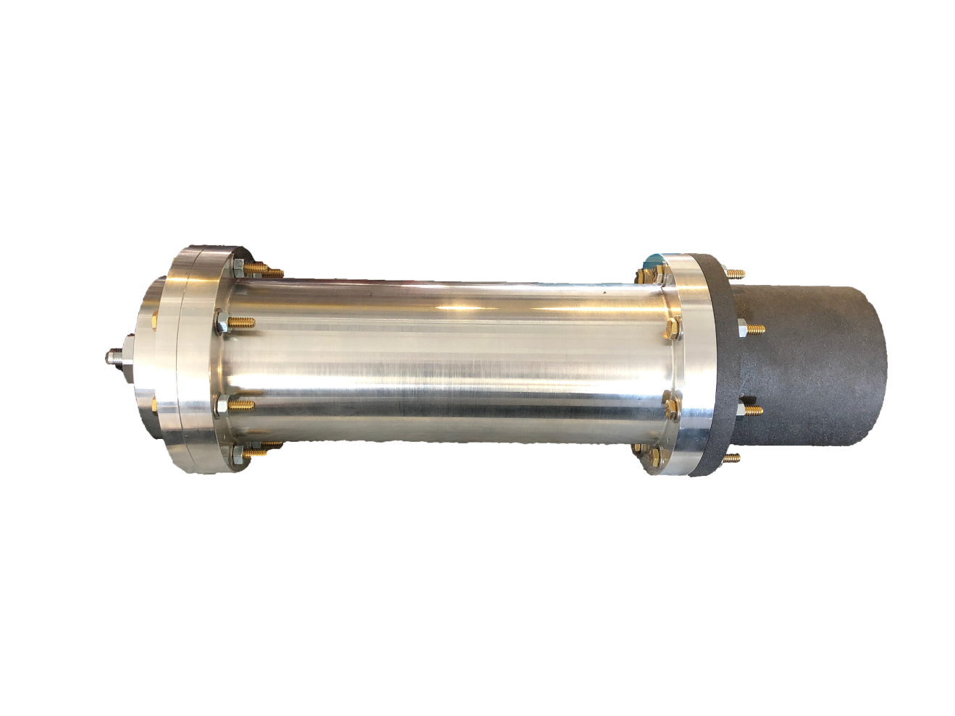
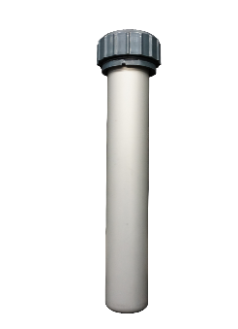
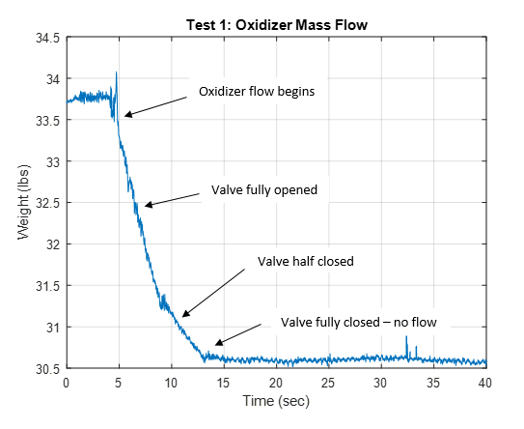
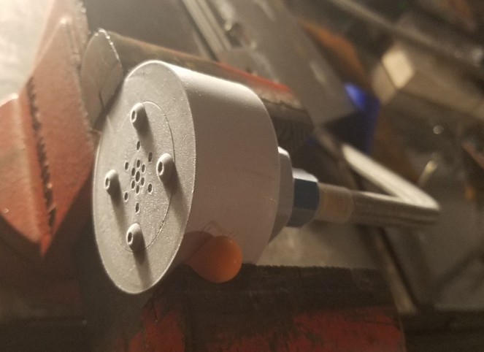
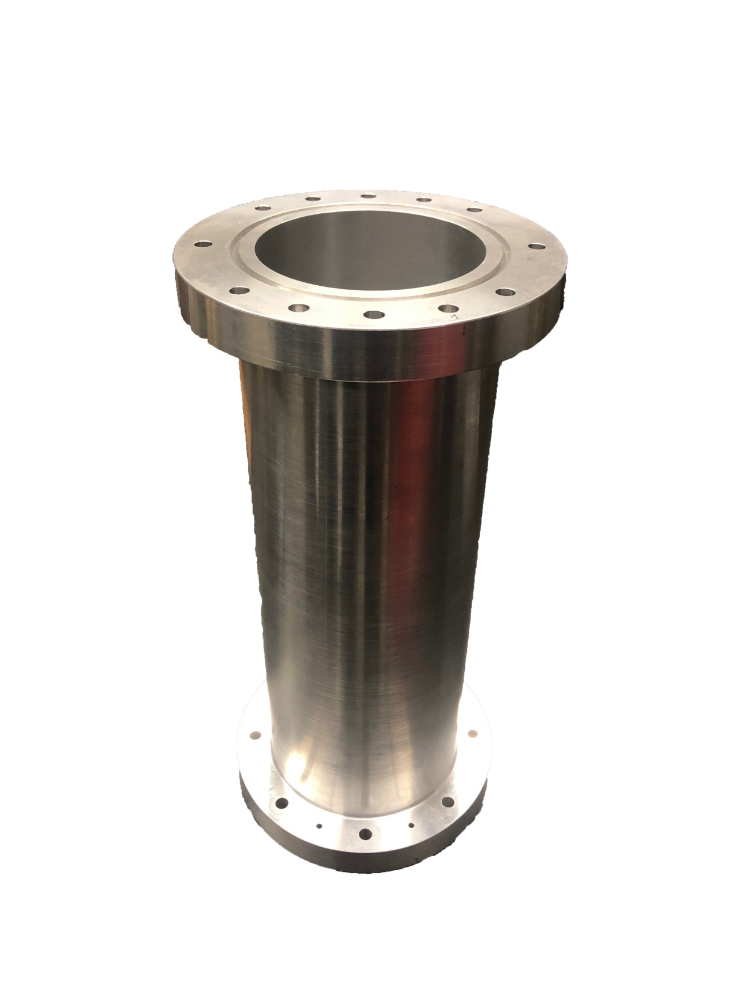



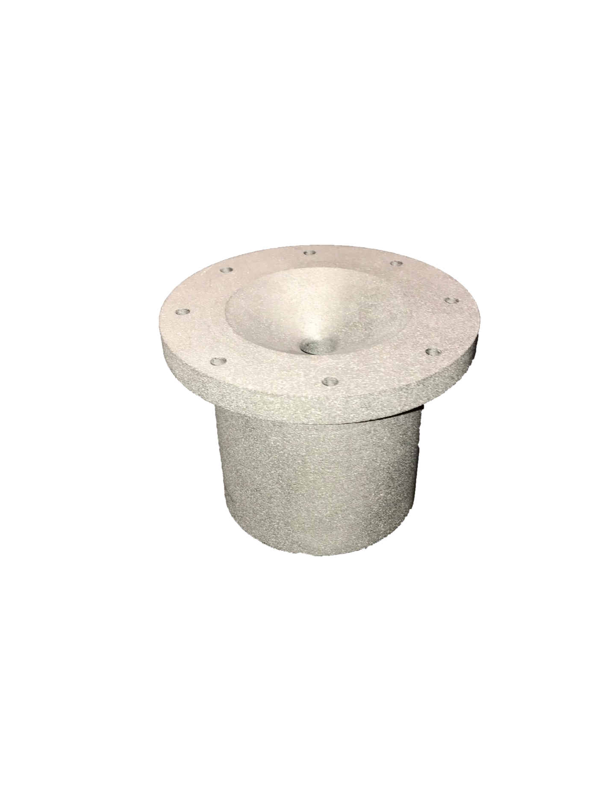
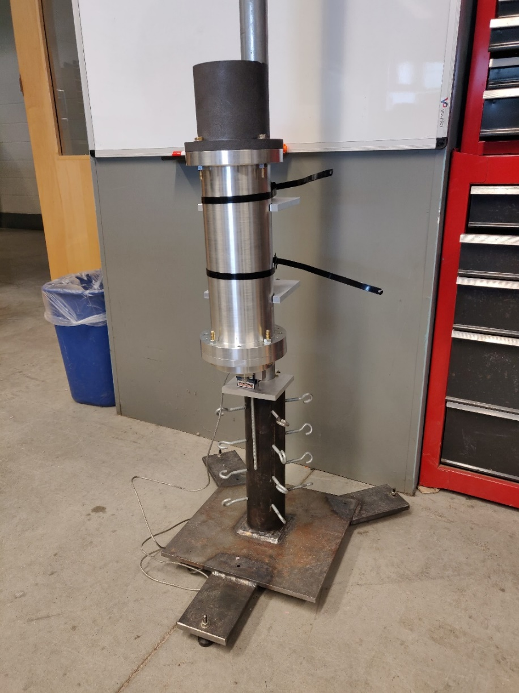

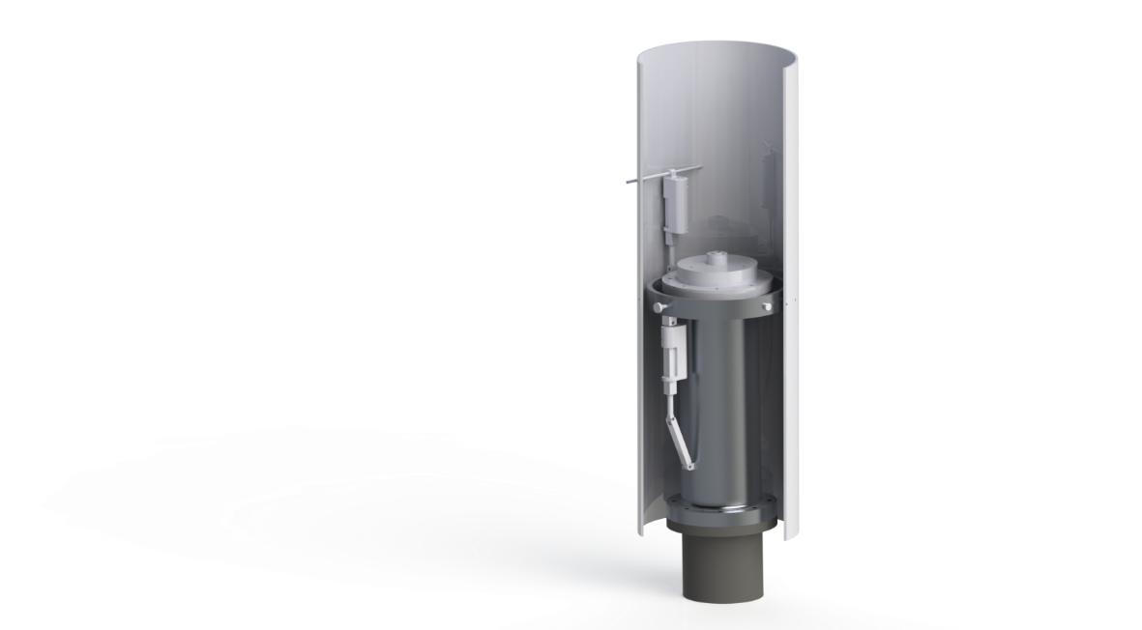
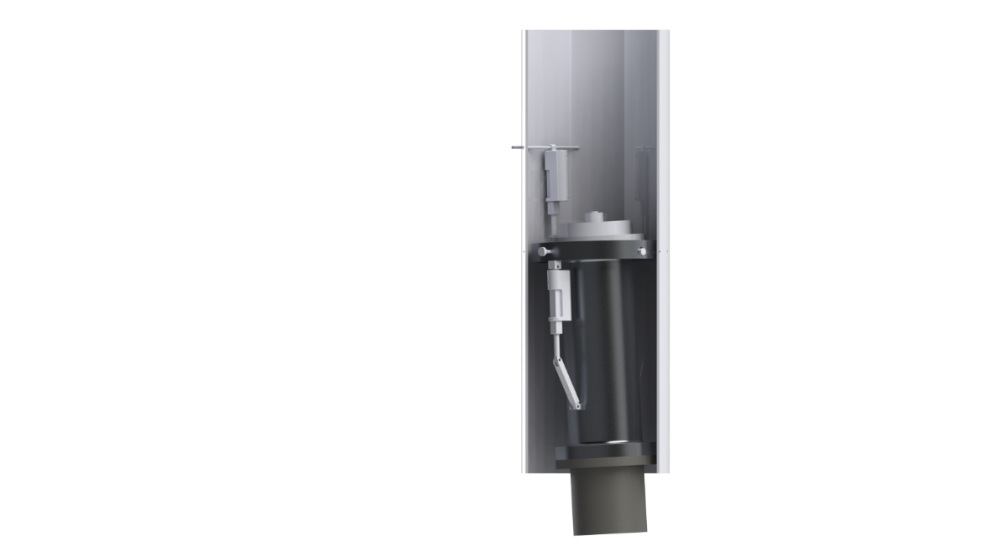
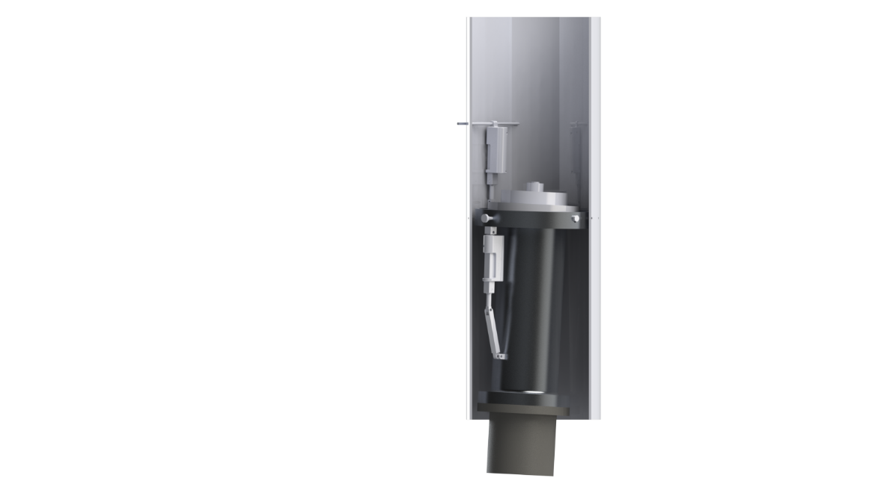
Department of Mechanical Engineering
Authors: Charlie Nitschelm, Andrew Hosman, Collin Stroshine, Ryan Blatti, Chase Eldridge, Tyler Landry, John Langer, Thomas Collins, Silas Johnson
Advisor: Dr. Todd Gross
Who We Are
A second year engineering organization comprised of students of all classes and CEPS majors
A primary engineering goal of pursuing the art of high power rocketry with custom-made hybrid engines
Fuel Selection and Flow Regulation
Hydroxyl-terminated polybutadiene (HTPB) and liquid nitrous oxide were chosen as the reducer and oxidizer, respectively.
A mold was 3-D printed to insert into the combustion chamber to form the HTPB into a circular grain.
The flow regulator controls the amount of flow into the combustion chamber, permitting throttle, cutoff, and reignition
Oxidizer Tank
A highly pressurized vessel that
contains liquid Nitrous Oxide,
acting as our oxidizer within
the combustion chamber
Flow Regulator
A motorized valve that monitors flow regulation
of the oxidizer into the injection plate controlled
by an electric motor and
an Arduino.
SpaceVision, November 2018
SEDS Rocketry Competition, October 2018
Injection Plate
Responsible for providing desired oxidizer flow into the combustion chamber with the assistance of the impinging plate
The 3 Year Plan
Year One
Year Three
Oxidizer Injection
A cold test fire was conducted to examine the oxidizer flow through the injector insert, and to determine the mass flow rate
Tested the flow regulation system
Attempted to determine how far we must open the flow regulator in order to get optimal flow through the injector plate
Hybrid Engine
Design
Manufacture
Test
Impinging Plate
An interchangeable cylindrical plate responsible for the impingement and atomization of the oxidizer flow streams
Runaway
Rocket Building
Simulating
Launching
Optimizing
Hybrid Rocket
Engine Optimization
Rocket Integration
Competition
Combustion Chamber
An enclosed volume where the solid reducer and liquid oxidizer react to produce a superheated, highly pressurized chamber of gas
Year Two
Combustion and Ignition
Ignition in combustion chamber creates an increase in temperature and pressure.
Flow atomizes, converting liquid nitrous oxide into a gaseous state.
Propellants react with each other creating thermal energy transforming into kinetic energy.
Hot Fire Test
Test engine to determine thrust produced, mass flow rate, thermal conductivity, and durability of engine.
Load cells and thermocouples used to record desired data.
Nozzle
Graphite was machined into a de Laval curve responsible for directing the flow of hot gases outside of the combustion chamber into the environment providing thrust
Thrust Vectoring
Current Work
Improve flow regulation design by reworking gears
Continue to test engine and create optimal design
Integrate manufactured gimbal parts onto the engine
Simulate rocket trajectory and altitude from hot fire test data
A gimbal ring is used to provide a second rotational piece that is placed between the engine and the rocket body
Two actuators positioned 90 degrees apart enable pitch and yaw control
Acknowledgments
A huge thanks to all the members of UNH SEDS, Scott Campbell, Dr. Ivo Nedyalkov, Dr. Alireza Ebadi, Sheldon Parent, Andy Globe, Dave Emanuel, Chief Dean, Ronald O’Keefe, TURBOCAM International, Reilly Webb, the UNH Makerspace and our advisor Dr. Todd Gross for all the support

Slide 2

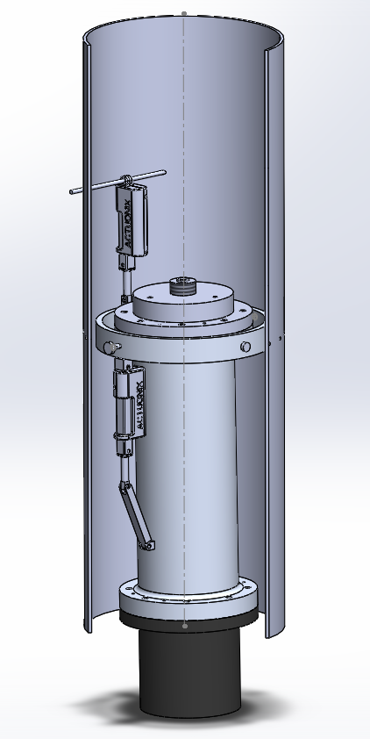
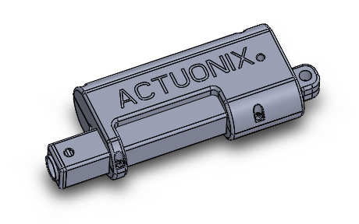
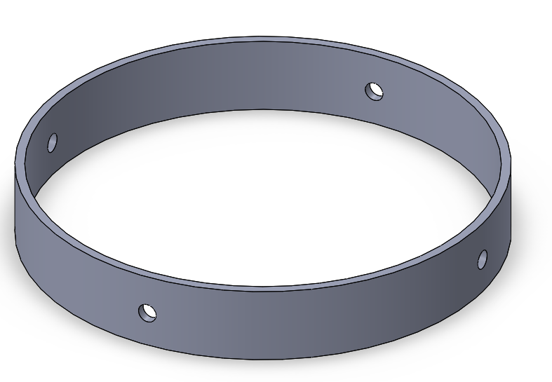
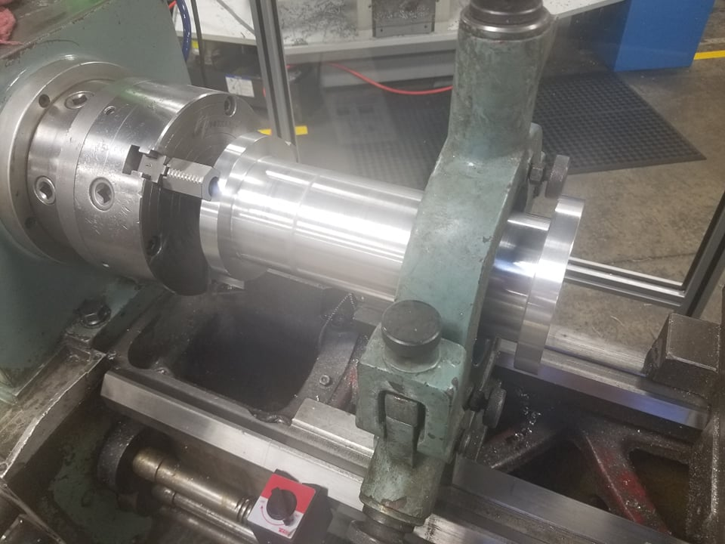
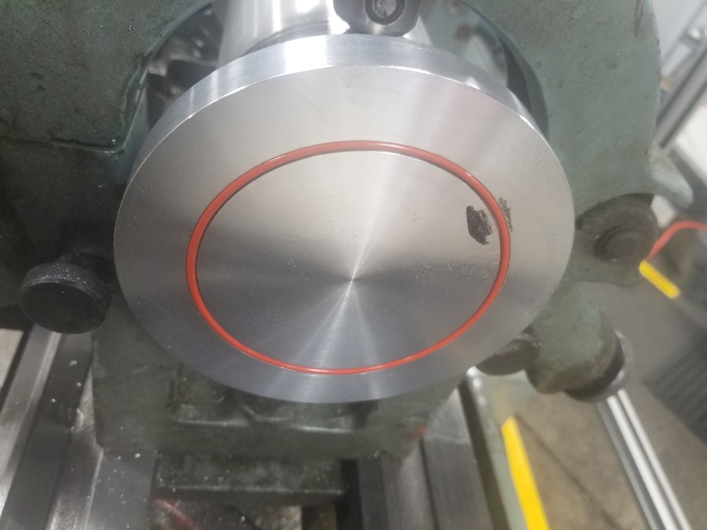
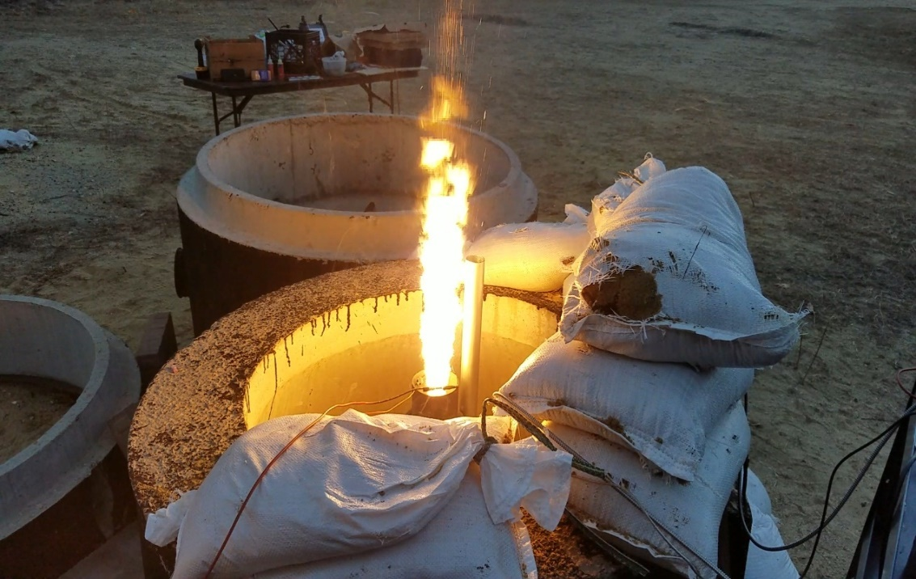
Vertical Static Test Fire Rig
Engine Startup / Ignition Method
Correct ignition method to start-up the engine and provide initial heat and pressure for further combustion with the oxidizer
Obtain an initial injector flow rate
Hot Fire Testing Rig and Data Collection
Used to safely test the hybrid rocket engine in a static rig
Collect precise data on thrust, mass flow rate and combustion temperature for future optimization of the hybrid rocket engine geometry
Gimbal System
Preliminary design work was started last year on commercial off the shelf 29mm engines to assist in the application of those techniques on a larger, homemade hybrid engine
HHHHH
Two actuators will be utilized to control the pitch and yaw of our thrust vector through flight
An accelerometer will be used to sense any variation in our zenith direction, and quickly redirect our engine thrust to return back to the desired flight path
Manufacturing
The combustion chamber and Injector plate were manufactured with the assistance of TURBOCAM International
Both components made of Aluminum 6061 for ease of manufacturing and Tripoli Experimental Rocket Recommendations
Injector plate designed so the plate can be reused, but hole inserts can be redesigned and replaced
The nozzle was manufactured here at UNH by Scott Campbell

